Slide 1
KS4 Activities
The Welsh rhythm in Dylan Thomas’s work

Slide 2
Did Dylan Thomas speak Welsh?
No, he probably didn’t, but his parents were first-language Welsh speakers.
They gave him a Welsh name from the Mabinogion – meaning ‘Prince of Darkness’, but didn’t speak Welsh to him.
Welsh was considered a ‘second-class language’ at the beginning of the 20th century.
English was the language ‘to get on in the world’.

Slide 3
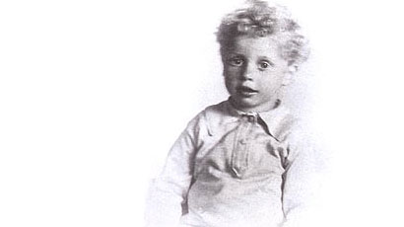
Did Dylan Thomas understand Welsh?
Welsh-speaking relatives would call by in 5, Cwmdonkin Drive, and he spent childhood holidays in the Welsh-speaking Llansteffan area.
According to his grand-daughter Hannah Ellis, Dylan heard and understood Welsh conversations but took part in English.
Many critics agree that his understanding of Welsh influenced his poetry.

Slide 4
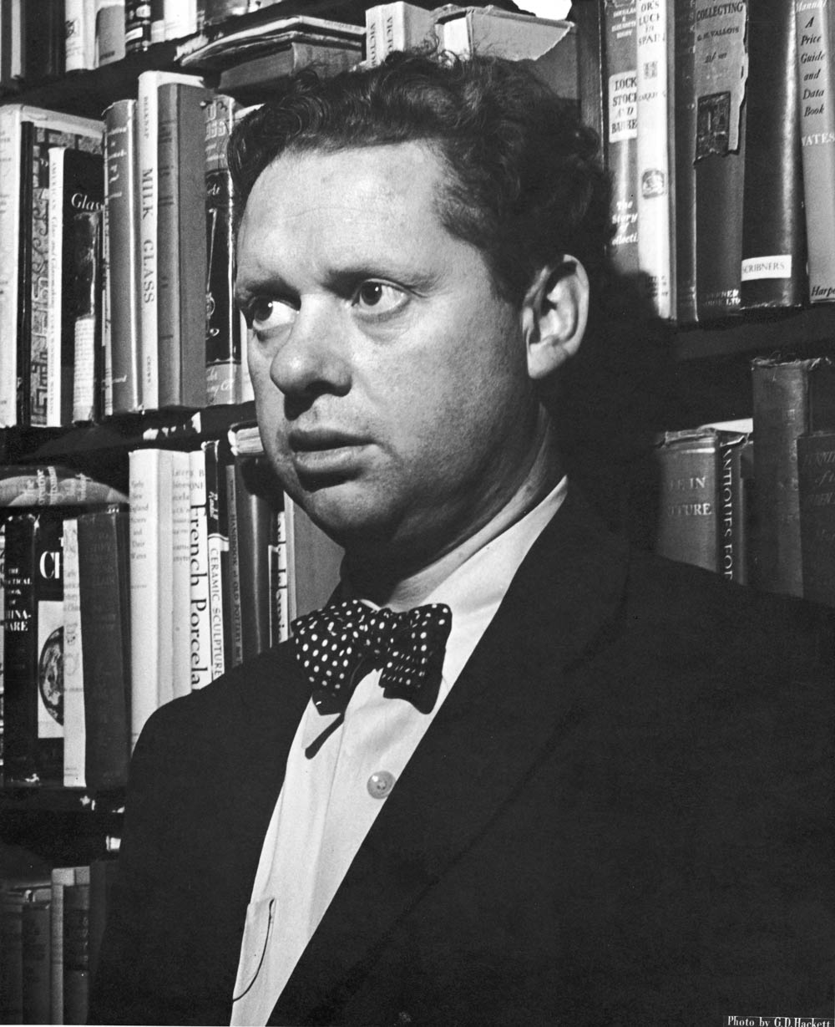
Dylan knew of Welsh poetry
His father had an extensive library.
Aneirin Talfan Davies, a colleague at the BBC, recalled that Dylan used to question him on the rules of ‘cynghanedd’ – Welsh strict metre poetry.
Dylan told his fellow poet Glyn Jones that if he had learnt Welsh, he would probably have composed Welsh strict metre poetry.

Slide 5
English poets and Welsh poetry
William Barnes, Thomas Hardy, Robert Graves and Gerard Manley Hopkins are all examples of poets who were influenced by Welsh strict metre poetry.
http://en.wikipedia.org/wiki/File:GerardManleyHopkins.jpg
Gerard Manley Hopkins (1844-1889) spent time in Wales studying theology, learnt some Welsh and came under the influence of strict metre poets. He, in turn, influenced Dylan Thomas.

Slide 6
Task 1: Say these lines by Gerard Manley Hopkins out loud, then mark the alliteration and/or rhyme. These are features of ‘cynghanedd’ in Welsh, which Hopkins loosely imitates and experiments with:
The blood-gush blade-gash
The down-dugged ground-hugged grey
Warm-laid grave of a womb-life grey
Hack and rack the growing green
Christ’s lily and beast of the waste wood

Slide 7
Task 1 answers: (alliteration in bold, rhyme in italics)
The blood-gush blade-gash
The down-dugged ground-hugged grey
Warm-laid grave of a womb-life grey
Hack and rack the growing green
Christ’s lily and beast of the waste wood

Slide 8
Dylan Thomas follows the rules of ‘cynghanedd’ more closely than Hopkins.
Task 2
Say these lines out loud. Now, mark the alliteration and rhyme. Can you work out the pattern which is identical in each one?
To the burn and turn of time
When the morning was walking over the war
Easy in the mercy of his means
Though the town below lay leaved with October blood

Slide 9
Task 2 answers:
These lines can be split into three parts:
Parts 1 and 2 rhyme; parts 2 and 3 have alliteration:
To the burn /and turn / of time
When the morning /was walking / over the war
Easy / in the mercy /of his means
Though / the town below / lay leaved with October blood
This is called ‘cynghanedd sain’ in Welsh.

Slide 10
Task 3
Say out loud these lines of Dylan’s work which involve alliteration only. Can you see a pattern?
Though I sang in my chains like the sea
The house that lies in the head

Slide 11
Task 3 answers:
Though I sang / in my chains like the sea
th s [n m ch ns l k] th s
The house /that lies in the head
th h [th t l s n] th h
Both lines have a repeated series of alliteration, with other consonants ‘in the way’. This is called ‘cynghanedd draws’ in Welsh.

